Slide 1


Cyclistic
Maximizing Anuual Memeberships
PREPARED BY KRISTINA YURIM KANG
Notes:
Good morning, everyone. I'm Kristina, and today I'm excited to present insights on 'Cyclistic: Maximizing Annual Memberships.' As we explore the data, we'll uncover strategies to enhance our annual membership base.

Slide 2
Table of Contents
Objective
Business Background
Business Task
Key Findings
Proposed Business Plans
Notes:
Here's a quick overview of what we'll cover today:
Objective: We aim to maximize annual memberships by deriving insights for targeted marketing strategies, specifically focusing on converting casual riders into annual members.
Business Background: A closer look at Cyclistic's extensive bike-share program, user behavior, pricing structures, and our marketing efforts.
Business Task: Understanding the differences in how annual members and casual riders use Cyclistic bikes.
Key Findings: Insights into peak usage times, trip duration disparities, and preferred docking area.
Proposed Business Plans: Actionable strategies to optimize user engagement and boost annual memberships.
Now, let's get started.

Slide 3

Objective
MAXIMIZING ANNUAL MEMBERSHIPS
To derive insights that can inform targeted marketing strategies, specifically aiming to convert casual riders into annual members
Notes:
Our primary objective is to maximize annual memberships.
Our specific focus is on converting casual riders into committed annual members.

Slide 4

Business Background
BIKE-SHARE PROGRAM OVERVIEW
Notes:
Now, let's delve into Cyclistic's rich business background.

Slide 5
Business Background
BIKE-SHARE PROGRAM OVERVIEW
5,824 bikes
692 docking stations
Notes:
We operate an extensive bike-share program with 5,824 bikes strategically placed across 692 docking stations. This infrastructure ensures widespread accessibility, forming the backbone of our service.

Slide 6
Business Background
BIKE-SHARE PROGRAM OVERVIEW
USER BEHAVIOR STATISTICS
5,824 bikes
692 docking stations
8% assistive bikes
30% for daily commuting
Notes:
Approximately 8% of our riders use assistive bikes, highlighting Cyclistic's commitment to inclusivity. Furthermore, 30% of our users choose Cyclistic bikes for their daily commute, showcasing the practical utility of our service.

Slide 7
Business Background
BIKE-SHARE PROGRAM OVERVIEW
USER BEHAVIOR STATISTICS
5,824 bikes
692 docking stations
8% assistive bikes
30% for daily commuting
TYPES OF RIDERS
casual riders - single-ride & full-day passes
Cyclistic members - annual membership
Notes:
In terms of pricing, we offer flexible plans to cater to various user preferences. Casual riders can opt for single-ride or full-day passes, providing choices that align with their needs. For committed users, Cyclistic members enjoy the benefits of an annual membership plan, offering a convenient and cost-effective solution for regular riders.

Slide 8
Business Background
BIKE-SHARE PROGRAM OVERVIEW
USER BEHAVIOR STATISTICS
5,824 bikes
692 docking stations
8% assistive bikes
30% for daily commuting
TYPES OF RIDERS
MARKETING INITIATIVES
casual riders - single-ride & full-day passes
Cyclistic members - annual membership
email
social media
Notes:
Cyclistic's marketing team engages our audience effectively through channels like email and social media. Supported by our marketing analytics team, we collect, analyze, and report data to guide data-driven strategies, ensuring our campaigns are impactful and resonate with our audience.

Slide 9

Business Task
How do annual members and casual riders use Cyclistic bikes differently?
Notes:
With this comprehensive background, let's outline our business task: understanding how annual members and casual riders use Cyclistic bikes differently.

Slide 10
Key Findings
Notes:
Now, onto the key findings. We've uncovered valuable insights into user behavior.

Slide 11
Key Findings
PEAK USAGE TIMES
Understanding Commuting Patterns
Notes:
Peak Usage Times:
We identified specific times during the day when annual members and casual riders prefer using Cyclistic bikes, providing insights into primary motivations behind bike usage, especially in relation to daily commuting habits.

Slide 12
Key Findings
PEAK USAGE TIMES
TRIP DURATION DISPARITIES
Understanding Commuting Patterns
Efficiency in Annual Members’ Commutes
Notes:
Trip Duration Disparities:
Differences in trip durations between annual members and casual riders were analyzed, revealing varying usage patterns, which we'll discuss in depth later on.

Slide 13
Key Findings
PEAK USAGE TIMES
TRIP DURATION DISPARITIES
PREFERRED DOCKING AREA
Understanding Commuting Patterns
Efficiency in Annual Members’ Commutes
Optimizing Bike Distribution Strategies
Notes:
Preferred Docking area:
By examining preferred docking areas, we identified regions where casual riders and annual members tend to start or end their trips more frequently.
This information is crucial for optimizing the placement of bikes and docking areas.

Slide 14
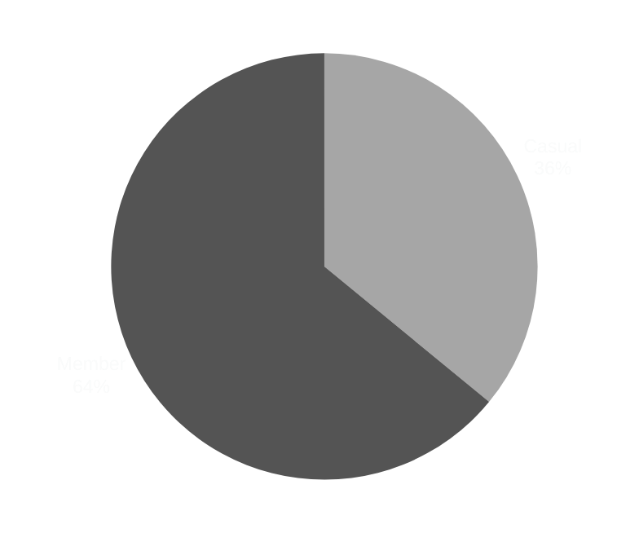
Total User Percentage
Notes:
Now, let's explore the breakdown of our user base.
Our analysis reveals that casual riders contribute to 36% of our trips, while members make up a substantial 64%. This pie chart provides a clear visualization of user engagement patterns.

Slide 15
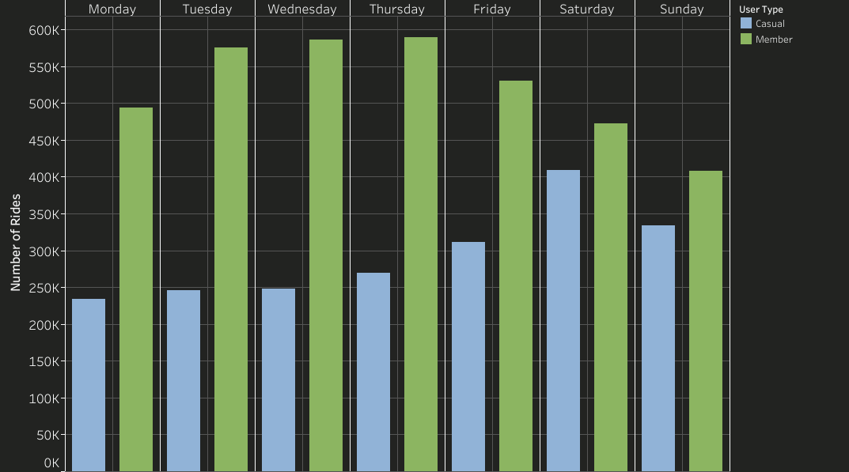
Ride Count by Day of The Week
Peak Usage Times
Notes:
Moving on to Peak Usage Times, casual riders show a higher count on weekends, indicating leisurely usage.
On the other hand, members display more consistent usage throughout weekdays, aligning with commuting patterns.

Slide 16
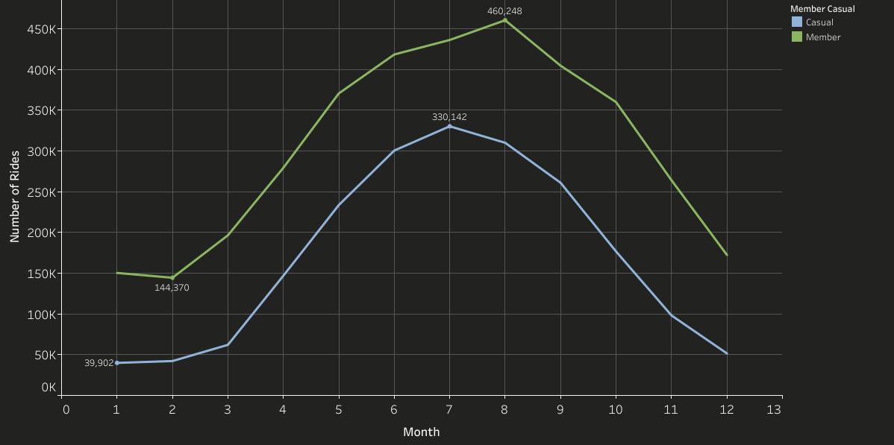
Ride Count by Month
Peak Usage Times
Notes:
Both Casual riders and annual members exhibit a similar pattern around a year with the highest count in July for casual riders and August for annual members.
These insights will guide our seasonal promotions and targeted campaigns.

Slide 17
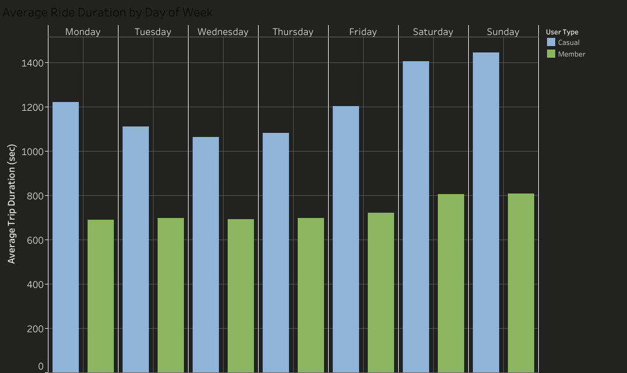
Trip Duration Disparities
Average Trip Duration by Day of The Week
Notes:
Shifting focus to Trip Duration Disparities, the graph here illustrates average trip durations by day of the week and user type.
Casual riders generally have longer trips, especially on weekends, while annual members maintain stable durations throughout weekdays.
These variations highlight distinct usage patterns.

Slide 18
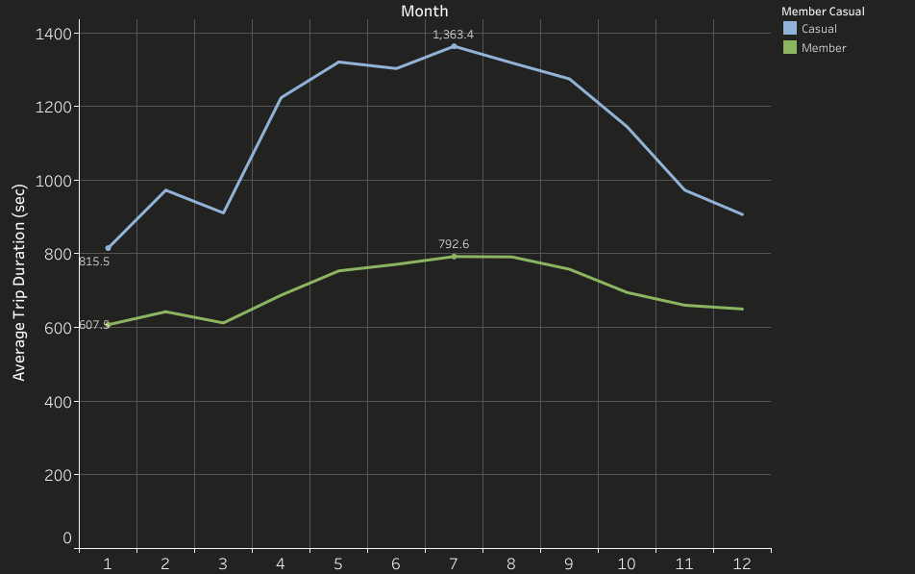
Trip Duration Disparities
Average Trip Duration by Month
Notes:
Continuing with Trip Duration Disparities, casual riders have longer durations in July, aligning with peak leisure times.
Members, however, maintain a consistent trend, with July being their longest durations. Understanding these patterns allows us to tailor marketing strategies effectively.

Slide 19
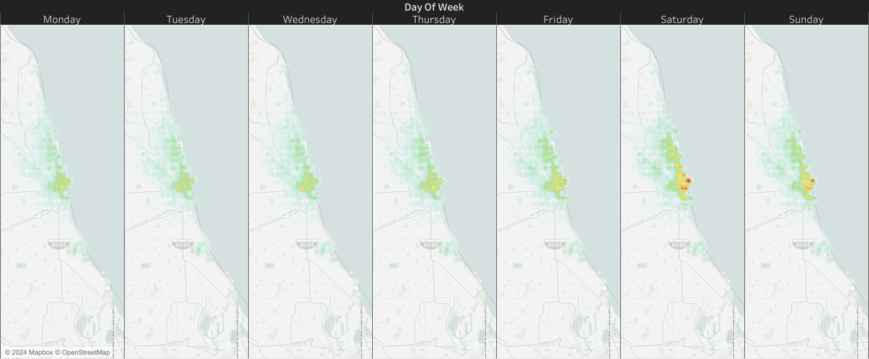
Preferred Docking Area: Casual
Notes:
Now, let's visualize Preferred Docking Areas.
We observe higher density on weekends along the coast of Lake Michigan, indicating areas of high recreational usage.

Slide 20
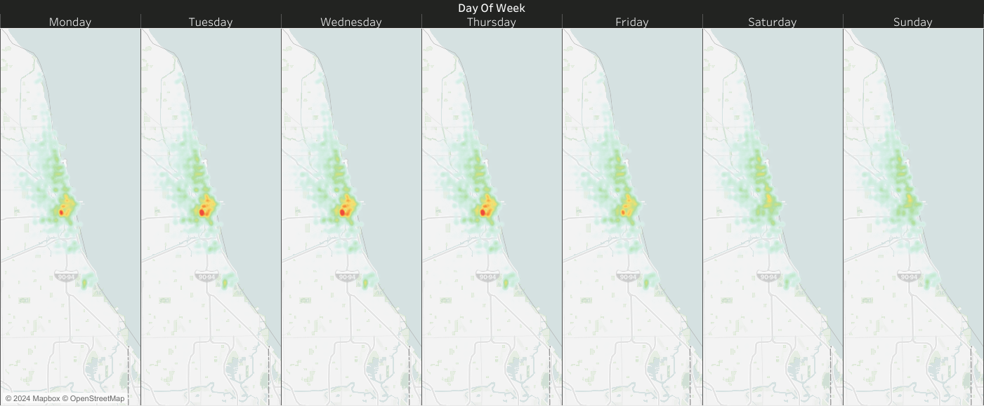
Preferred Docking Area: Member
Notes:
Shifting to annual members, our map showcases higher density on weekdays, particularly in inland areas.
Understanding these preferred docking areas is instrumental in optimizing bike placement and ensuring our bikes are readily available where our members need them the most.

Slide 21
Proposed Business Plans
Notes:
With our key findings in mind, we've crafted three strategic approaches to optimize user engagement and drive the conversion of casual riders into annual members.

Slide 22

Proposed Business Plans
1. WEEKDAY CONVENIENCE, WEEKEND ADVENTURE
Notes:
First up, it's targeted marketing strategies: Weekday Convenience, Weekend Adventure.
Casual riders show a preference for weekends, and to convert them into annual members, we will launch targeted weekday campaigns.

Slide 23

WEEKDAYS
WEEKENDS
Notes:
Our goal is to increase weekday ridership...

Slide 24
WEEKDAYS
WEEKENDS
15%
increase
Among casual riders
through promotions
emphasizing the ease of city commuting
Notes:
by 15% among casual users through promotions emphasizing the ease of city commuting.
Simultaneously, we aim to boost weekend usage among annual members...

Slide 25
WEEKDAYS
WEEKENDS
15%
20%
increase
increase
Among casual riders
through promotions
emphasizing the ease of city commuting
Among annual members
with flexible weekend adventure plans
of Chicago’s scenic routes
Notes:
by 20% by promoting flexible weekend adventure plans with specific scenic routes.

Slide 26
Proposed Business Plans
1. WEEKDAY CONVENIENCE, WEEKEND ADVENTURE
Notes:
Next up, we have ...

Slide 27

Proposed Business Plans
1. WEEKDAY CONVENIENCE, WEEKEND ADVENTURE
2. CAPITALIZING ON PEAKS, BOOSTING IN VALLEYS
Notes:
Seasonal promotions, Capitalizing on Peaks, Boosting in Valleys.
Leveraging insights from peak usage times, the goal is to strategically implement seasonal promotions that not only maximize engagement during peak months but also encourage casual riders to transition into annual members during low-usage periods.

Slide 28


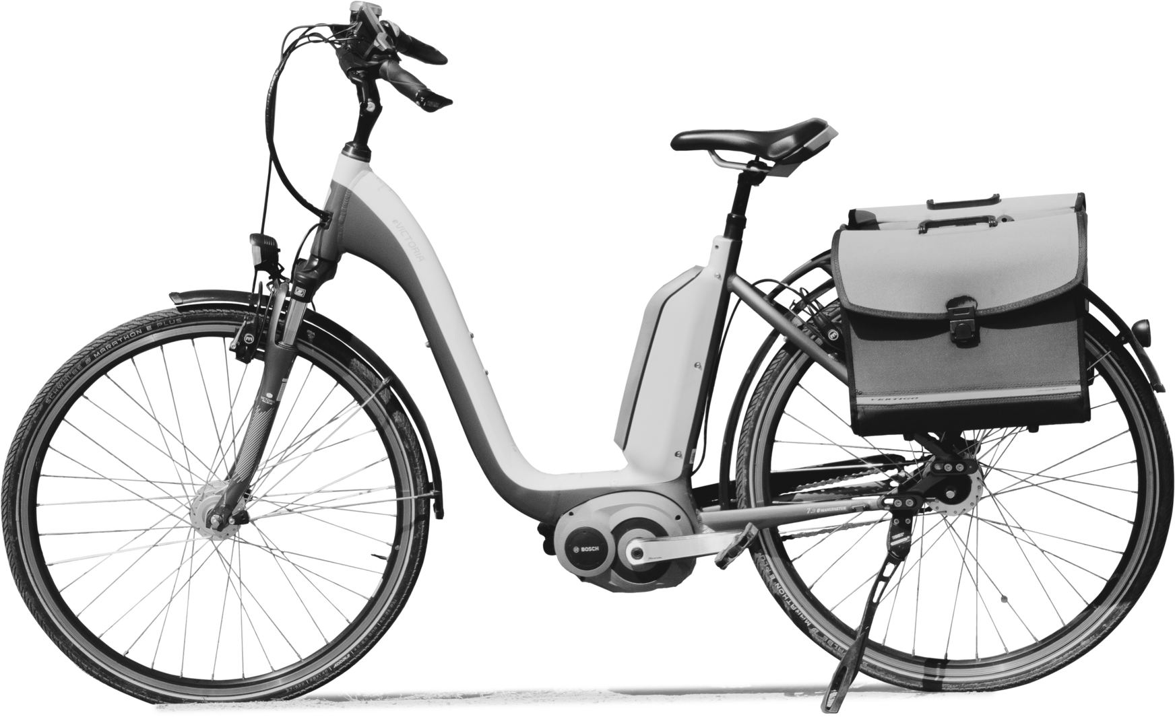
MAXIMIZE ENGAGEMENT
Notes:
During peak months, we aim to increase annual memberships ...

Slide 29
MAXIMIZE ENGAGEMENT
25%
Notes:
by 25% through exclusive offers and events that specifically target casual riders.
For example, ...

Slide 30
MAXIMIZE ENGAGEMENT
- limited time D/C
Exclusive Offers
Notes:
limited-time discounts on annual memberships during these peak months to incentivize casual riders to make a commitment.

Slide 31


EMPHASIZE BENEFIT OF MEMBERSHIPS
Notes:
In low-usage periods, our goal is to boost ridership ...

Slide 32
EMPHASIZE BENEFIT OF MEMBERSHIPS
20%
Notes:
by 20% among casual riders by introducing targeted promotions, such as ...

Slide 33
EMPHASIZE BENEFIT OF MEMBERSHIPS
1. Discounted single-ride passes
Notes:
discounted single-ride passes or ...

Slide 34
EMPHASIZE BENEFIT OF MEMBERSHIPS
1. Discounted single-ride passes
2. Referral Incentives
Notes:
referral incentives.
Simultaneously, emphasize the long-term benefits of an annual membership, encouraging casual riders to make the transition during these off-peak months.

Slide 35
Proposed Business Plans
1. WEEKDAY CONVENIENCE, WEEKEND ADVENTURE
2. CAPITALIZING ON PEAKS, BOOSTING IN VALLEYS
Notes:
Last but not least, it's geographically tailored strategy:

Slide 36

Proposed Business Plans
1. WEEKDAY CONVENIENCE, WEEKEND ADVENTURE
2. CAPITALIZING ON PEAKS, BOOSTING IN VALLEYS
3. COASTAL CONSERVATION COLLABORATION
Notes:
Coastal Conservation Collaboration strategy.
It aims to forge partnerships with local environmental organizations to promote sustainability while enhancing Cyclistic's brand presence.

Slide 37
Coastal Conservation Collaboration
GEOGRAPHICALLY TAILORED PROGRAM
Notes:
Let's break down the strategy.

Slide 38

Coastal Conservation Collaboration
GEOGRAPHICALLY TAILORED PROGRAM
PARTNERSHIP WITH ECO-ORGANIZATIONS
PROMOTION INTEGRATION
WIN-WIN COLLABORATION
Notes:
The strategy involves Partnership with Eco Organizations.
We will collaborate with Chicago Wilderness Alliance, a regional collaborative of hundreds of partner organizations and individuals working to implement landscape-scale approaches to conservation in and around the southern shores of Lake Michigan.

Slide 39


Coastal Conservation Collaboration
GEOGRAPHICALLY TAILORED PROGRAM
PARTNERSHIP WITH ECO-ORGANIZATIONS
PROMOTION INTEGRATION
WIN-WIN COLLABORATION
Notes:
Promotion Integration.
We will integrate our promotions with an eco-friendly initiative called Green Vision Initiatives, led by Chicago Wilderness Alliance.
For every bike rental made through Cyclistic's platform during weekends along the Lake Michigan coast,

Slide 40
Coastal Conservation Collaboration
GEOGRAPHICALLY TAILORED PROGRAM
For every bike rental,
5%
PARTNERSHIP WITH ECO-ORGANIZATIONS
PROMOTION INTEGRATION
WIN-WIN COLLABORATION
Notes:
5% of the proceeds are donated to Green Vision Initiatives, funding eco-friendly projects they lead.

Slide 41

Coastal Conservation Collaboration
GEOGRAPHICALLY TAILORED PROGRAM
X
PARTNERSHIP WITH ECO-ORGANIZATIONS
PROMOTION INTEGRATION
WIN-WIN COLLABORATION
Notes:
Because they are actively involved in conservation efforts, we can utilize their strong presence among local communities and visitors.
Therefore, it is a Win-Win Collaboration.
By aligning our promotions with Chicago Wilderness Alliance and possibly many others in the future, we create a win-win situation.
Cyclistic gains visibility among environmentally conscious consumers who frequent the coastal areas, while our partner organizations receive support for their conservation efforts.

Slide 42

Seeking Your Input
Notes:
As we move forward, your input is invaluable.
Please feel free to share your insights and perspectives.

Slide 43
EMAIL ADDRESS
Contact Information
kristina.yurim.kang@gmail.com
LINKEDIN
linkedin.com/in/kristina-yurim-kang
GET IN TOUCH!
GITHUB
github.com/kristina-kang
Notes:
If you have any further questions, suggestions, or would like to discuss the findings in more detail, please feel free to get in touch.
You can reach me through one of these methods mentioned in the slide.
Thank you so much for your time.

